Slide 1

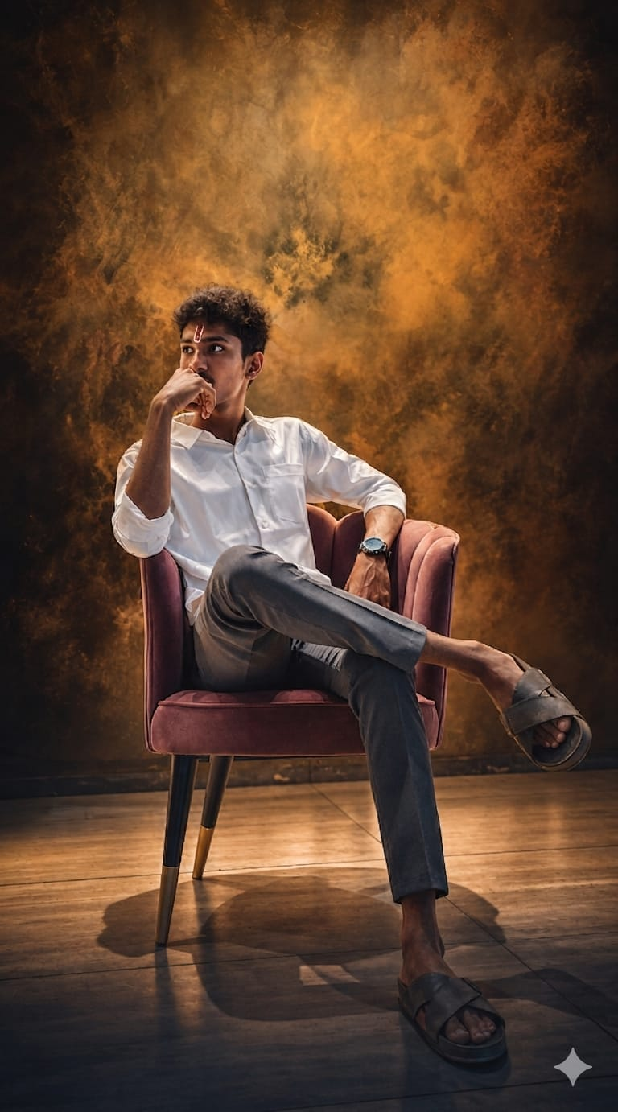


CREATIVE PORTFOLIO
web developer
Portfolio
CREATIVE PORTFOLIO
Mohan Raju TAMMU

Slide 2




Introduction
Hi, I'm Mohan Raju Tammu, a passionate Web Developer and technology enthusiast. I specialize in creating responsive, user-friendly, and modern websites using the latest web technologies. I enjoy transforming ideas into functional digital experiences and continuously expanding my skills in web development, cybersecurity, and emerging technologies such as Generative AI. As a lifelong learner, I am committed to building innovative solutions and growing as a professional in the tech industry.

Slide 3




CREATIVE PORTFOLIO
Technical skillS
HTML5
CSS3
JavaScript
Responsive Web Design
Bootstrap
React.js (if learning)
Git & GitHub
Website Deployment
UI/UX Fundamentals
TOOLS
VISUAL STUDIO CODE ( VS CODE )
CANVA
FIGMA
GITHUB
CREATIVE PORTFOLIO

Slide 4

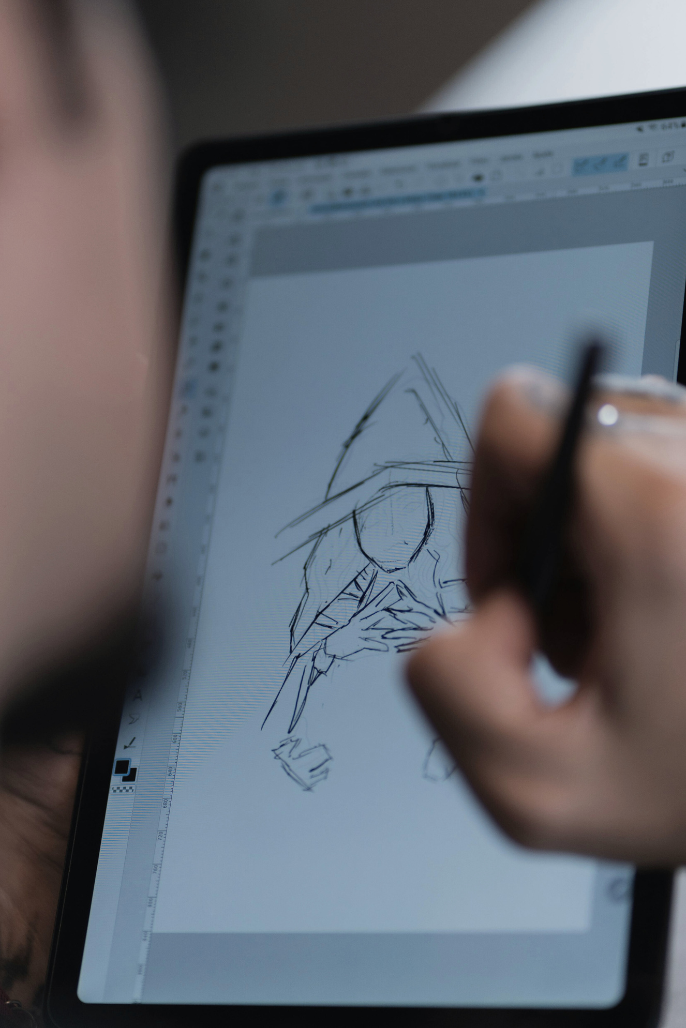
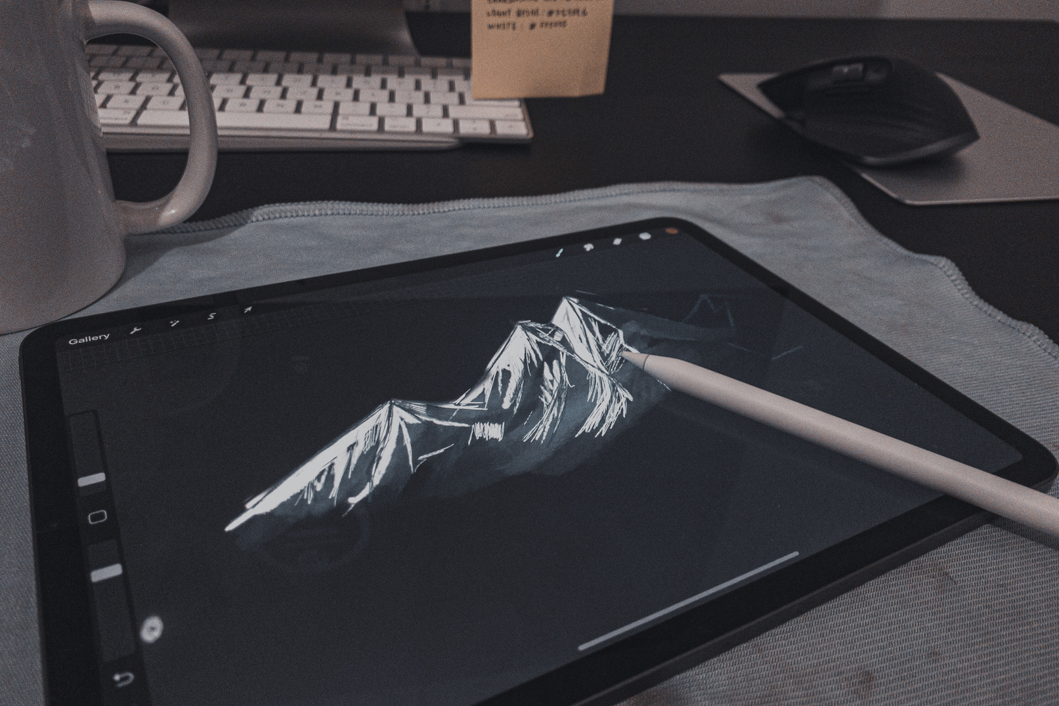
Goals
My goal as a Web Developer is to create modern, responsive, and user-friendly websites that provide excellent user experiences. I aim to continuously improve my technical skills, stay updated with the latest web technologies, and develop innovative digital solutions that solve real-world problems. I am passionate about learning new technologies, including Cybersecurity and Generative AI, to expand my expertise and build secure, efficient, and impactful web applications. Through dedication, creativity, and continuous learning, I aspire to grow into a highly skilled technology professional and contribute to the advancement of the digital world.

Slide 5
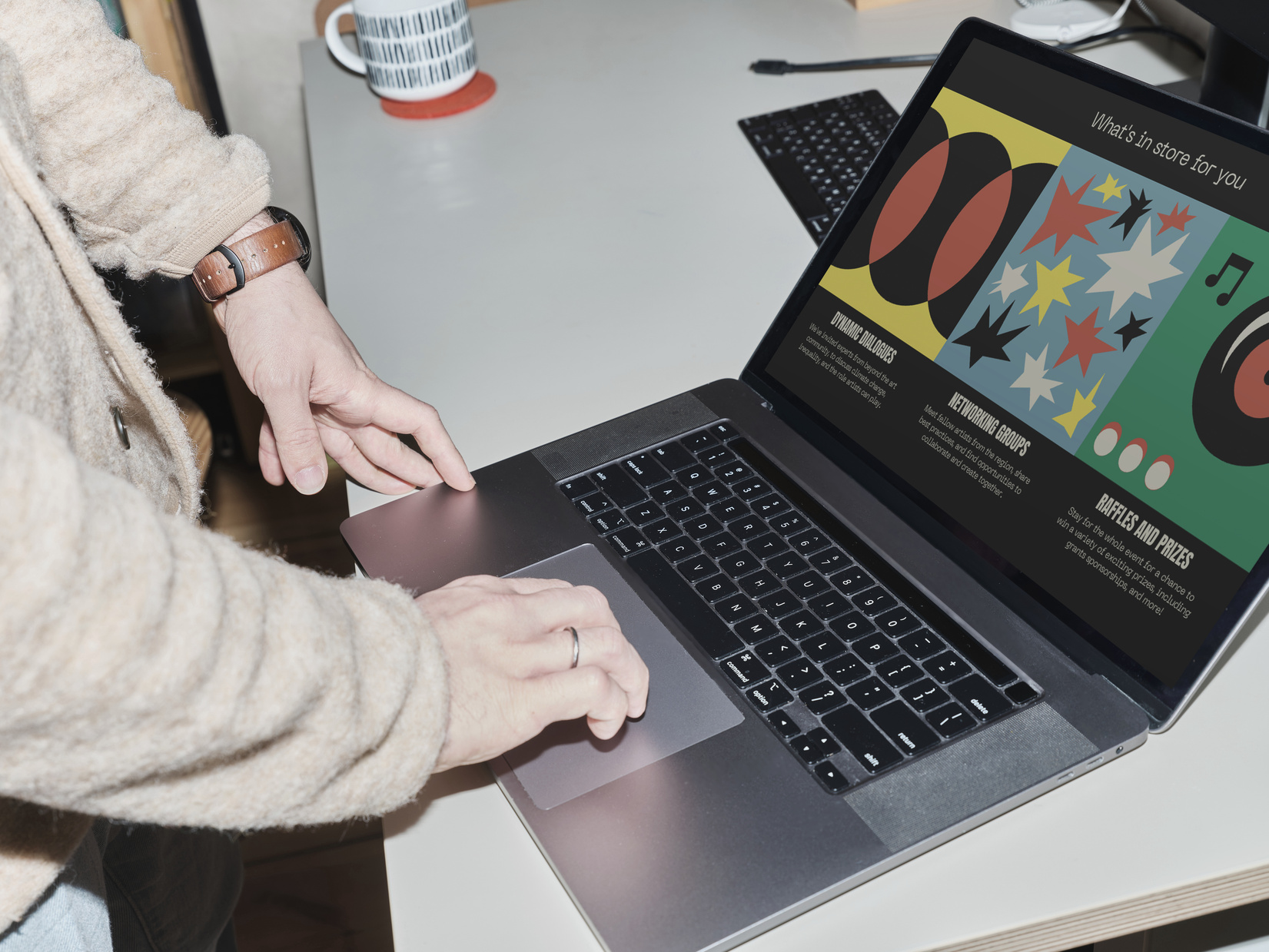
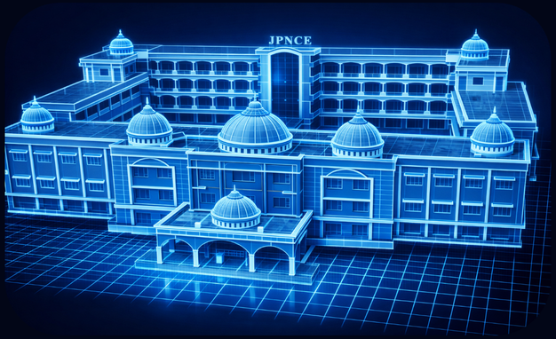
Project Overview
JPNCE COLLEGE ASSISTANT
Brief overview of the website purpose:
To support students & visitors with instant information.
The AI chatbot serves as a conversational guide for college related questions.
Focus on user-friendly interface + real-time response.
Software Reqiurements
Frontend: HTML, CSS, JavaScript
Backend: Python (Flask or similar)
Chatbot Engine: AI/JS le.g.backend or trained model) Used a default local device memory and processor as server
WEB SITE LINK :
https://jpnceassistant.ccbp.tech

Slide 6
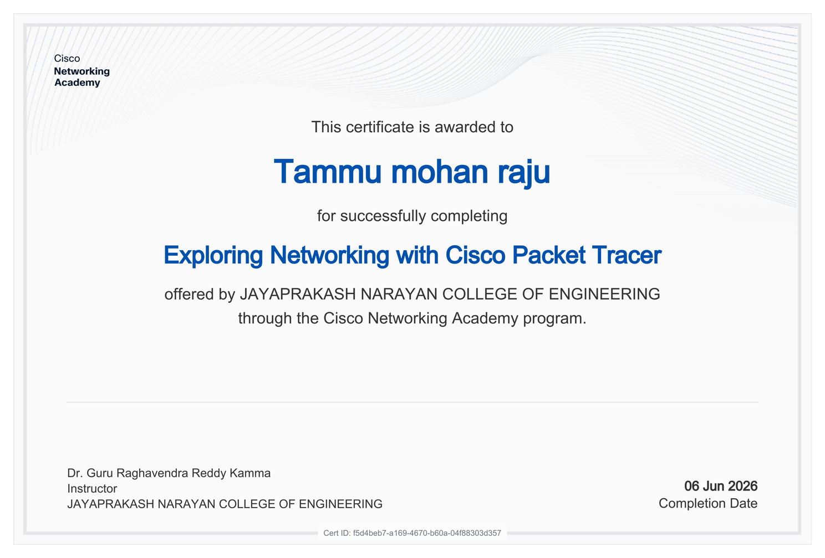
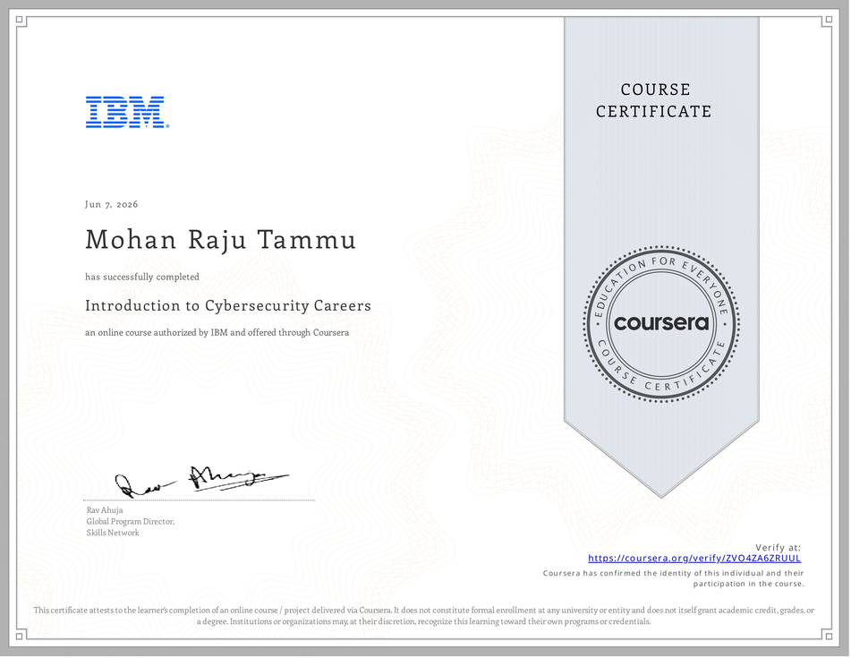
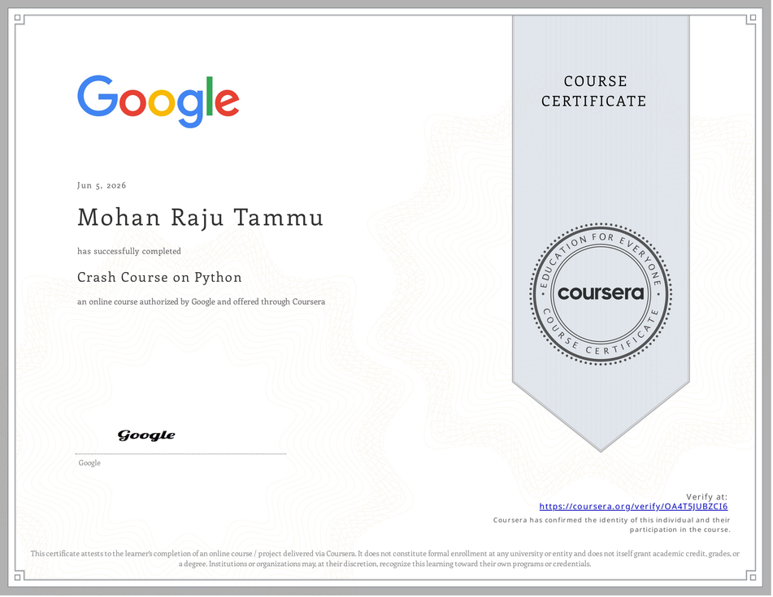
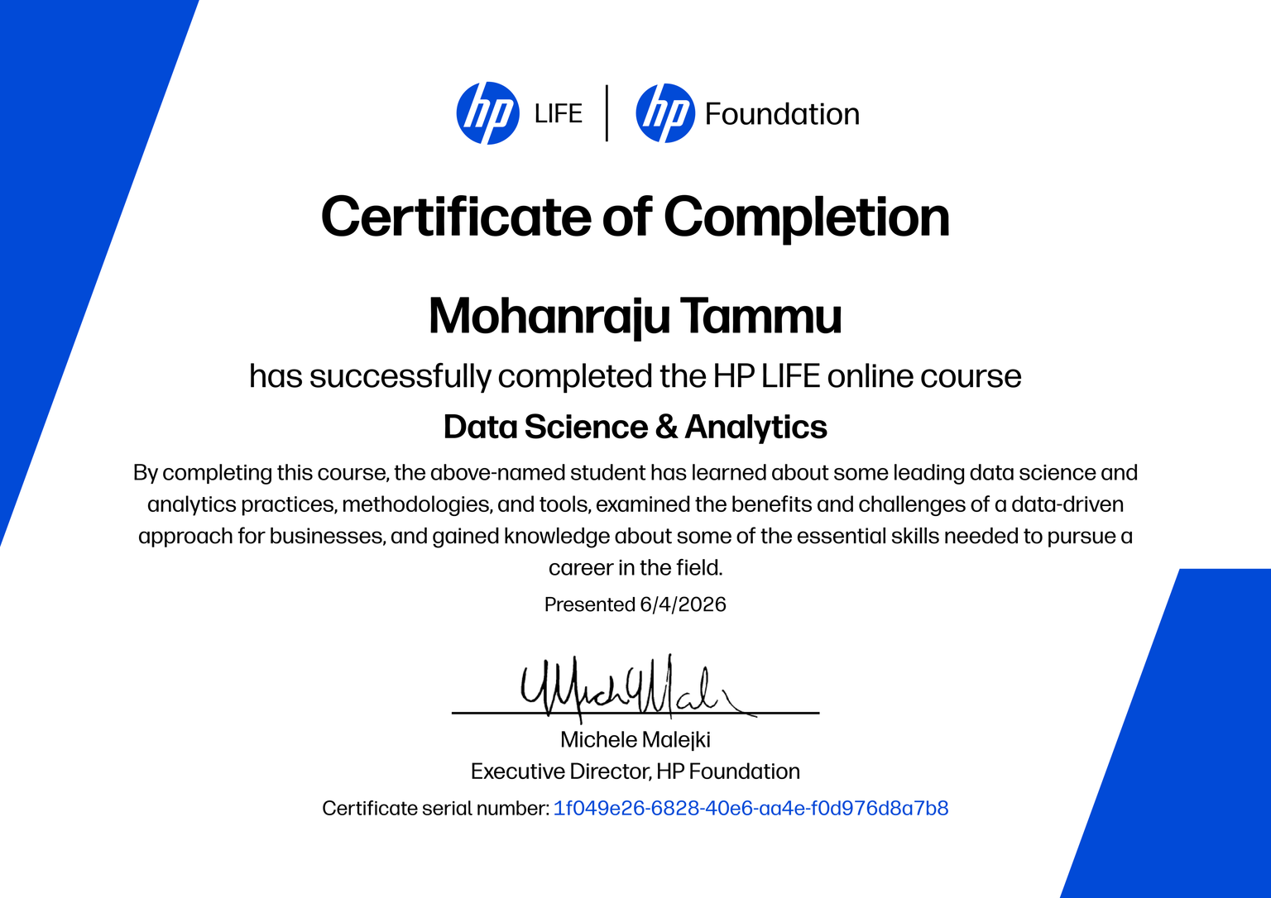
Documentation
"I am Mohan Raju Tammu, a passionate Web Developer and Cybersecurity learner. I have successfully completed professional certification programs from Google, IBM, Tata, and HP Foundation, which have strengthened my knowledge in technology, digital skills, problem-solving, and emerging technologies. These certifications reflect my commitment to continuous learning and professional growth. Alongside my web development journey, I am expanding my expertise in cybersecurity and Generative AI to stay updated with the latest industry trends and build innovative technology solutions for the future."

Slide 7

CREATIVE PORTFOLIO
Thank
You
CREATIVE PORTFOLIO
Mohan Raju Tammu

